Slide 1
Introduction to Angular
Creating an Angular application
Understanding the application

Slide 2
Section 1: Creating an Angular Application
Overview
Getting Angular CLI
Creating an application
Reviewing the application
Serving the application
Viewing the application

Slide 3
Overview
Angular is a client-side framework from Google
Makes it easier to develop large-scale rich Web apps
Angular CLI is a command-line interface tool that you can use to create a new Angular application
Scaffolds a complete template application
Generates appropriate config files
Reinforces best practices for file names, folders, etc.
Enables you to generate new artifacts in the application
3

Slide 4
Getting Angular CLI
Angular CLI is a Node.js application
You must install Node.js first (version 14 or above)
You can install Angular CLI on your machine as follows:
You can verify the version of Angular CLI installed:
npm install -g @angular/cli
ng version
4

Slide 5
Creating an Application
To create an Angular application using Angular CLI…
Run the following command from the command line:
You'll be asked a few questions:
Which stylesheet format would you like? (choose CSS)
Do you want to enable Server-Side Rendering? (choose N)
ng new DemoApp
5

Slide 6
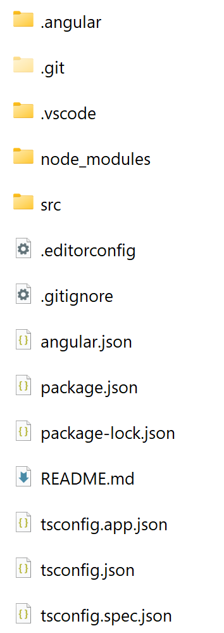
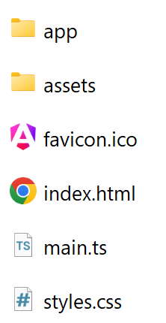
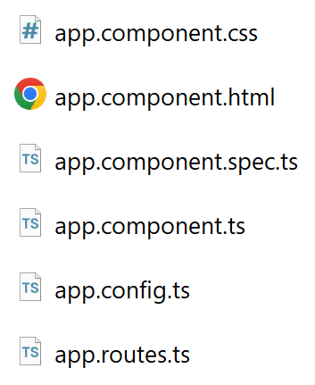
Reviewing the Application
Angular CLI creates a minimal fully functional Angular app:
src folder
src/app folder
6

Slide 7
Serving the Application
You can use Angular CLI to serve the application
Go to the application folder
Run the following command:
This command builds and serves the app in memory
Default host is localhost, default port is 4200
Use --host and --port for a different host and port
ng serve
7

Slide 8
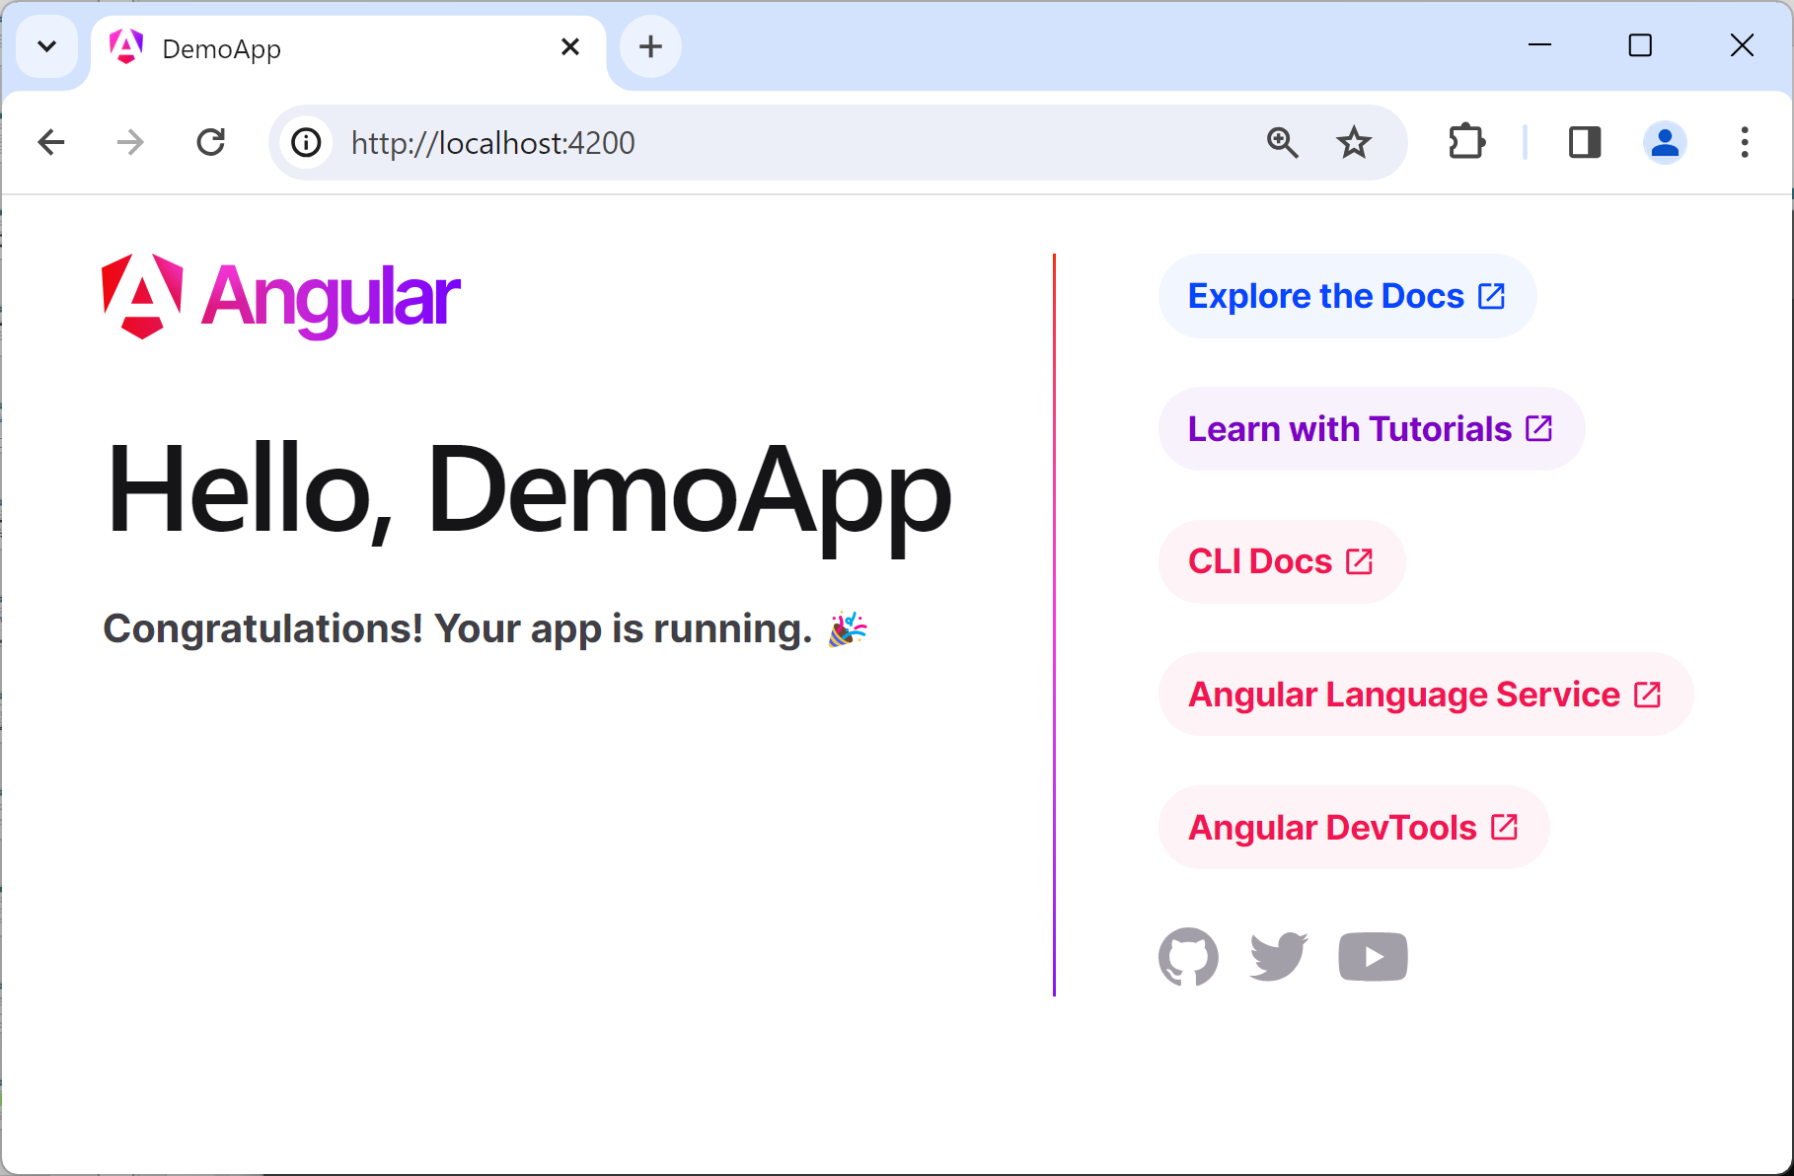
Viewing the Application
To view the app, browse to http://localhost:4200
The app automatically reloads if you change source files
8

Slide 9
Aside: Updating an Existing App
Angular comes out with a new version every 6 months
If you have an existing Angular app that you want to update to the latest version of Angular:
Uninstall your (old) version of Angular CLI
Then install the latest version of Angular CLI
Then run the following command:
ng update @angular/core @angular/cli --allow-dirty
9

Slide 10
Section 3: Understanding the Application
Overview
Key configuration files
Application home page
Main source file
AppComponent class

Slide 11
Overview
Angular applications have a lot of moving parts
There are a lot of config files and source files…
We'll take a quick journey through some of the key details in this section (details follow later in the course)
Config files
Application home page
Source code files (in TypeScript)
11

Slide 12
Key Configuration Files
package.json
Specifies Node.js dependencies (e.g. Angular libraries)
Specifies development tools (e.g. TypeScript transpiler)
Specifies command-line scripts (e.g. ng serve)
tsconfig.json
Configures the TypeScript transpiler
angular.json
Specifies application home page, src/index.html
Specifies main source file, src/main.ts
12

Slide 13
Application Home Page
Here's the application home page:
When the application is launched:
The <app-root> element is populated with content generated by our Angular application code
<!doctype html>
<html lang="en">
<head> … </head>
<body>
<app-root></app-root>
</body>
</html>
src/index.html
13

Slide 14
Main Source File
Here's the main source file in our application:
Bootstraps AppComponent, the main "component" in the application
See next slide for the definition of AppComponent
Btw we'll discuss appConfig later…
import { bootstrapApplication } from '@angular/platform-browser';
import { appConfig } from './app/app.config';
import { AppComponent } from './app/app.component';
bootstrapApplication(AppComponent, appConfig)
.catch((err) => console.error(err));
src/main.ts
14

Slide 15
AppComponent Class
In Angular, a component is a class that renders HTML
We've highlighted the important bits here
We'll discuss the other bits later…
import { Component } from '@angular/core';
import { CommonModule } from '@angular/common';
import { RouterOutlet } from '@angular/router';
@Component({
selector: 'app-root',
standalone: true,
imports: [CommonModule, RouterOutlet],
templateUrl: './app.component.html',
styleUrls: ['./app.component.css']
})
export class AppComponent {
title = 'DemoApp';
}
src/app/app.component.ts
15

Slide 16
Summary
Creating an Angular application
Understanding the application

